Slide 1
SOC 101: Introduction to Sociology
Socialization
Lecture: 5
Dr. Bulbul Ashraf Siddiqi
Associate Professor
Dept. of Political Science and Sociology

Slide 2


Slide 3
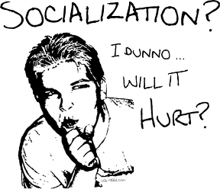

Slide 4
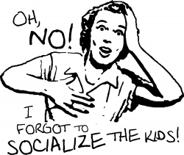

Slide 5
What is Socialization?
Sociologists, in general, are interested in the patterns of behaviour and attitudes that emerge throughout the life course, from infancy to old age.
Socialization is the lifelong process, in which people learn the attitudes, values, and behaviours appropriate for members of a particular culture.
Socialization occurs through human interactions that begin in infancy and continue through retirement.
We learn a great deal from those people most important in our lives—immediate family members, best friends, and teachers.
We also learn from people we see on the street, on television, on the Internet, and in films and magazines.

Slide 6
Socialization helps us
to discover how to behave “properly” and what to expect from others if we follow (or challenge) society’s norms and values.
To understand the process of transmission of a culture from one generation to the next, to ensure the long-term continuity of a society.
To understand the process of development of personality.

Slide 7
What would happen if anyone does not have any opportunity to interact with others?
Try to imagine
Give some examples (if you have any in your mind)
What makes us who we are?

Slide 8
The Role of Socialization
Social Environment: The Impact of Isolation
In the 1994 movie Nell, Jodie Foster played a young woman hidden from birth by her mother in a backwoods cabin. Raised without normal human contact, Nell crouches like an animal, screams wildly, and speaks or sings in a language all her own. This movie was drawn from the actual account of an emaciated 16-year-old boy who appeared mysteriously in 1828 in the town square of Nuremberg, Germany (Lipson 1994).

Slide 9
The Case of Isabelle:
For the first six years of her life, Isabelle lived in almost total seclusion in a darkened room. She had little contact with other people, with the exception of her mother, who could neither speak nor hear. Isabelle’s mother’s parents had been so deeply shamed of Isabelle’s illegitimate birth that they kept her hidden away from the world. Ohio authorities finally discovered the child in 1938, when Isabelle’s mother escaped from her parents’ home, taking her daughter with her.

Slide 10
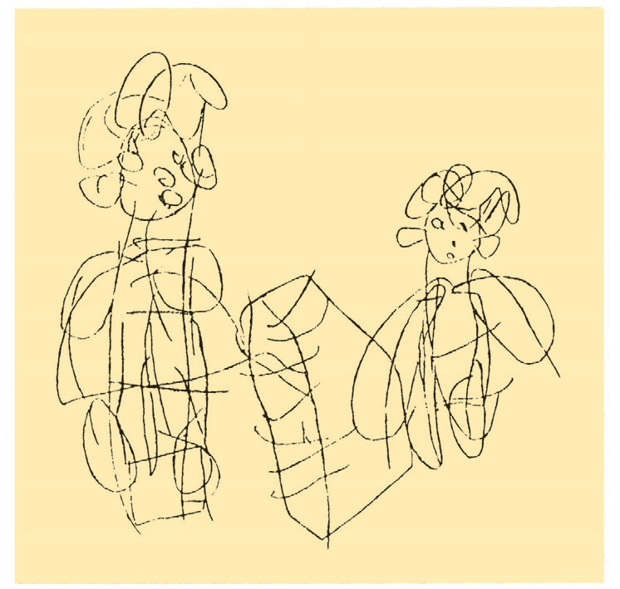
This sketch was made in 1975 by Genie—a girl who had been isolated for most of her 14 years, until she was discovered by authorities in 1970. In her drawing, her linguist friend (on the left) plays the piano while Genie listens. Genie was 18 when she drew this picture. Source: Curtiss 1977:274.

Slide 11
Primate Studies also shows similar findings (Harlow, 1971)
What Events in your life had a strong influence on who you are?
Group Discussion

